Slide 1
AMES HOUSING PROJECT
MODELING HOUSING DATA FOR AMES, IOWA Using Regression Techniques

Slide 2
What are the best predictors of Home Value in Ames Iowa?
Problem Statement:
Guidelines for buyers, sellers, developers, and everyone in between.

Slide 3
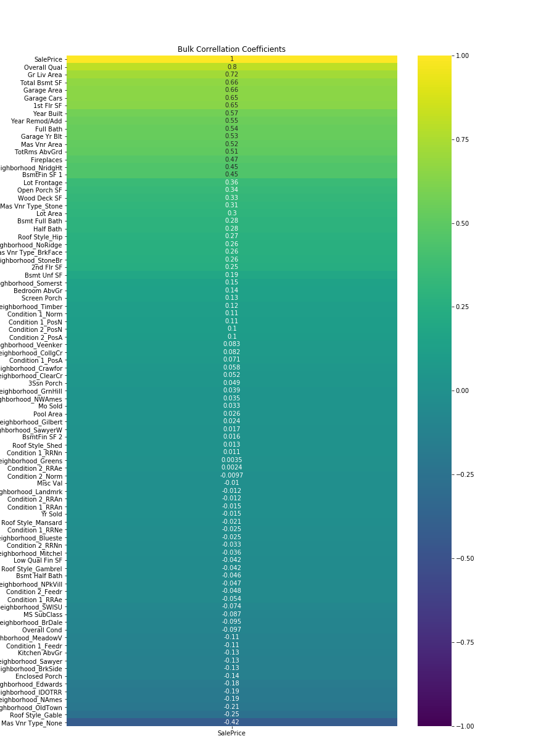
Methodology
As many people in the room are aware, the dataset we have for the Ames Iowa location is large, and a bit overwhelming at first, see fig
The basic process I adopted was train, test, repeat.
While the initial dataset included 80 different features, through trial and error, checking the effect on the model and the variance inflation factor, I narrowed it down to 46

Slide 4
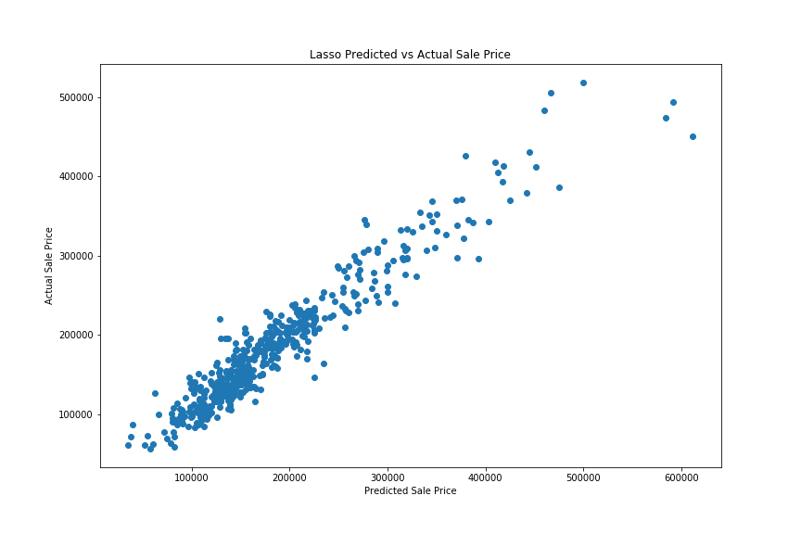
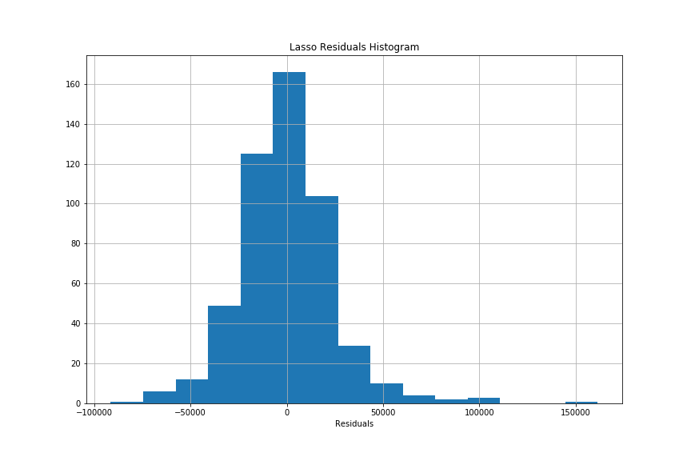
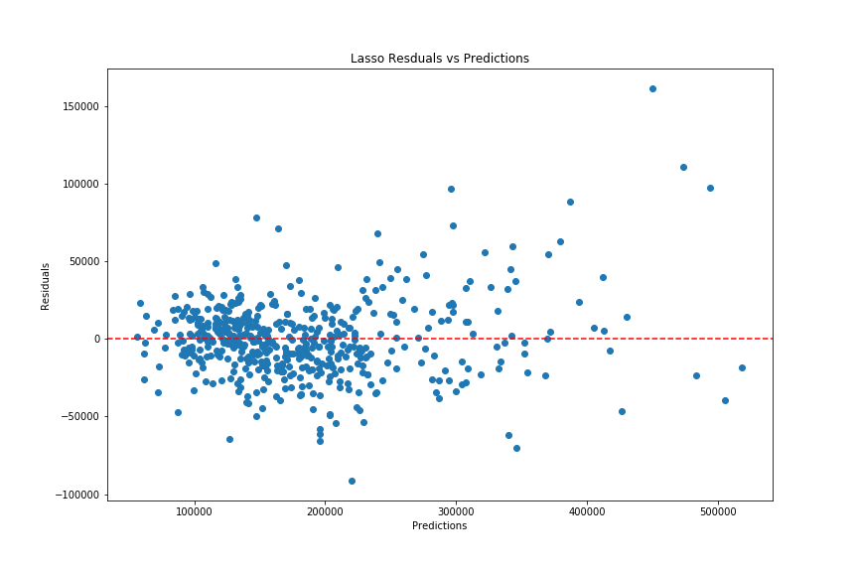
Lasso CV
Predicted Price Vs Actual Price is a straight diagonal line
Residuals Histogram is roughly normal
Residuals vs Predictions is showing more of a pattern than the Linear Regression model

Slide 5
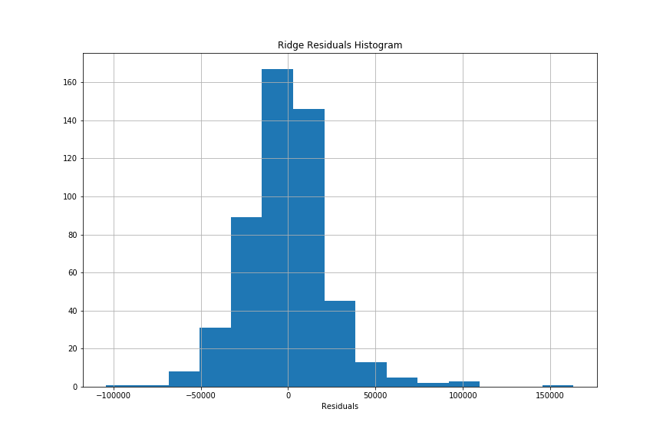

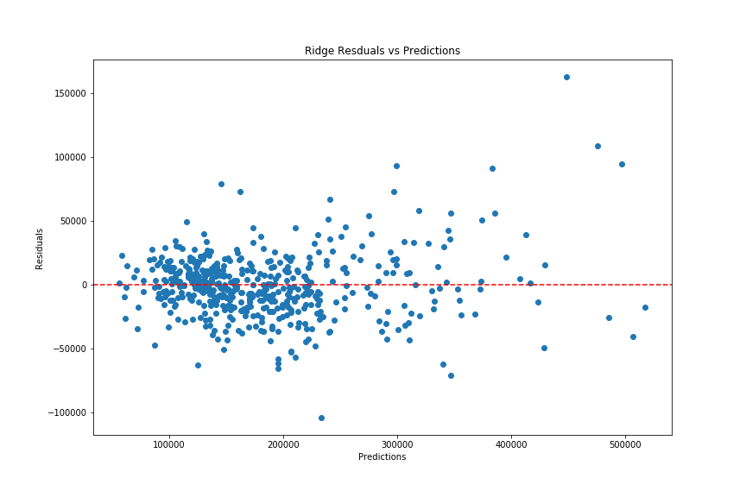
Ridge Regression
Predicted Price Vs Actual Price is a straight diagonal line
Residuals Histogram shows a right skew
Residuals vs Predictions is not showing a strong pattern

Slide 6
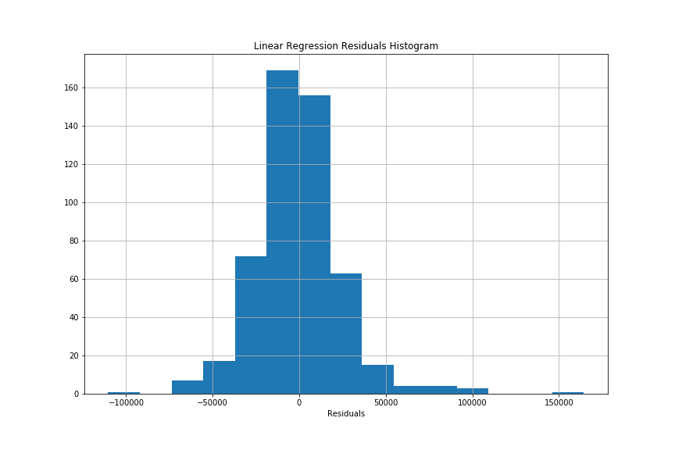

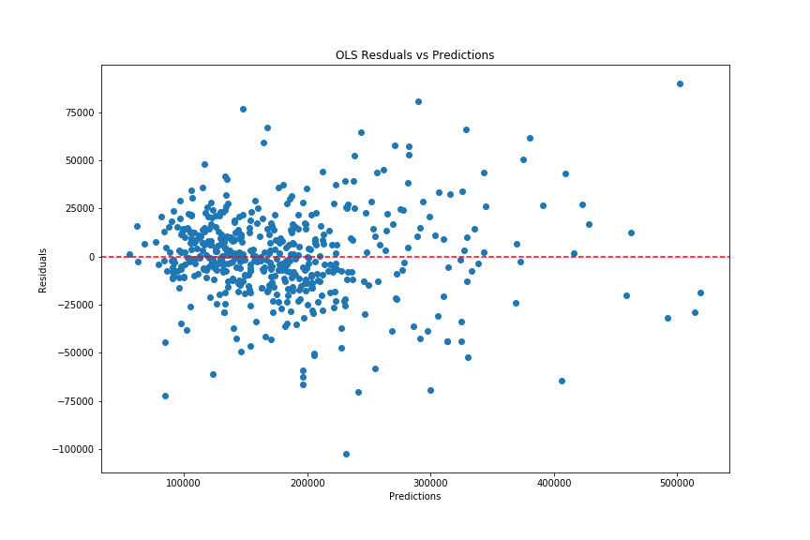
Linear Regression
Predicted Price Vs Actual Price is a straight diagonal line
Histogram is roughly normal
Residuals vs Predictions is not showing a strong pattern

Slide 7
Model Evaluation Metrics
Examining the coefficients of this model account for 87.6% of the variation in the Sale Price
Train: 88.8%
Test: 85.6%
The model predicts sale price within a margin of $ 22,942 (RMSE)

Slide 8
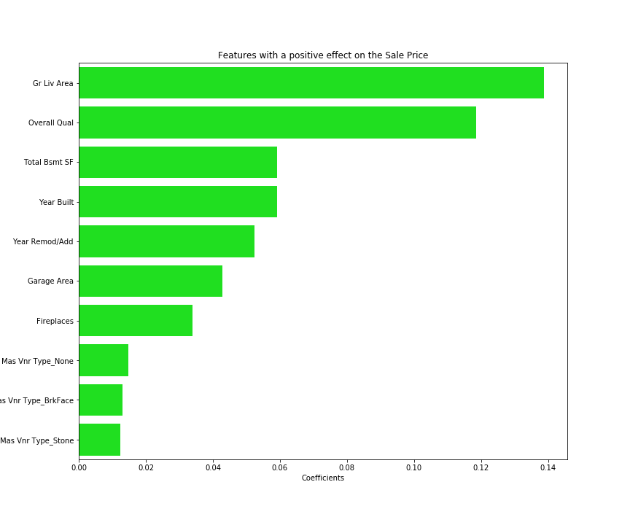
Positive Feature Effects
Above Ground Living Area
Overall Quality of Building Materials
Total Basement Square Footage

Slide 9
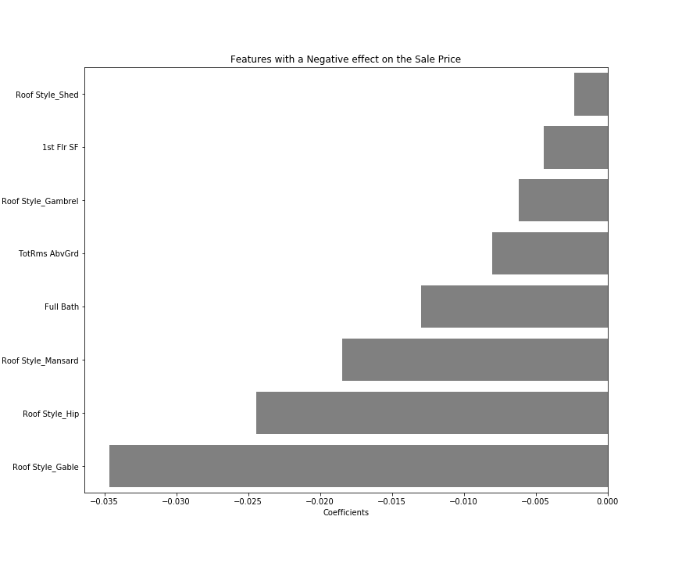
Negative Feature Effects
Gabled Roof
Hip Style Roof
Mansard Style Roof

Slide 10
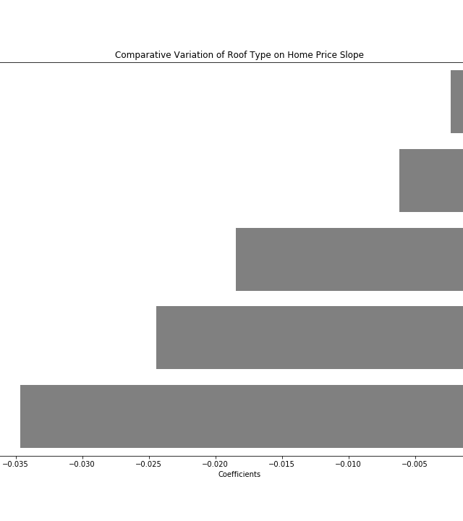
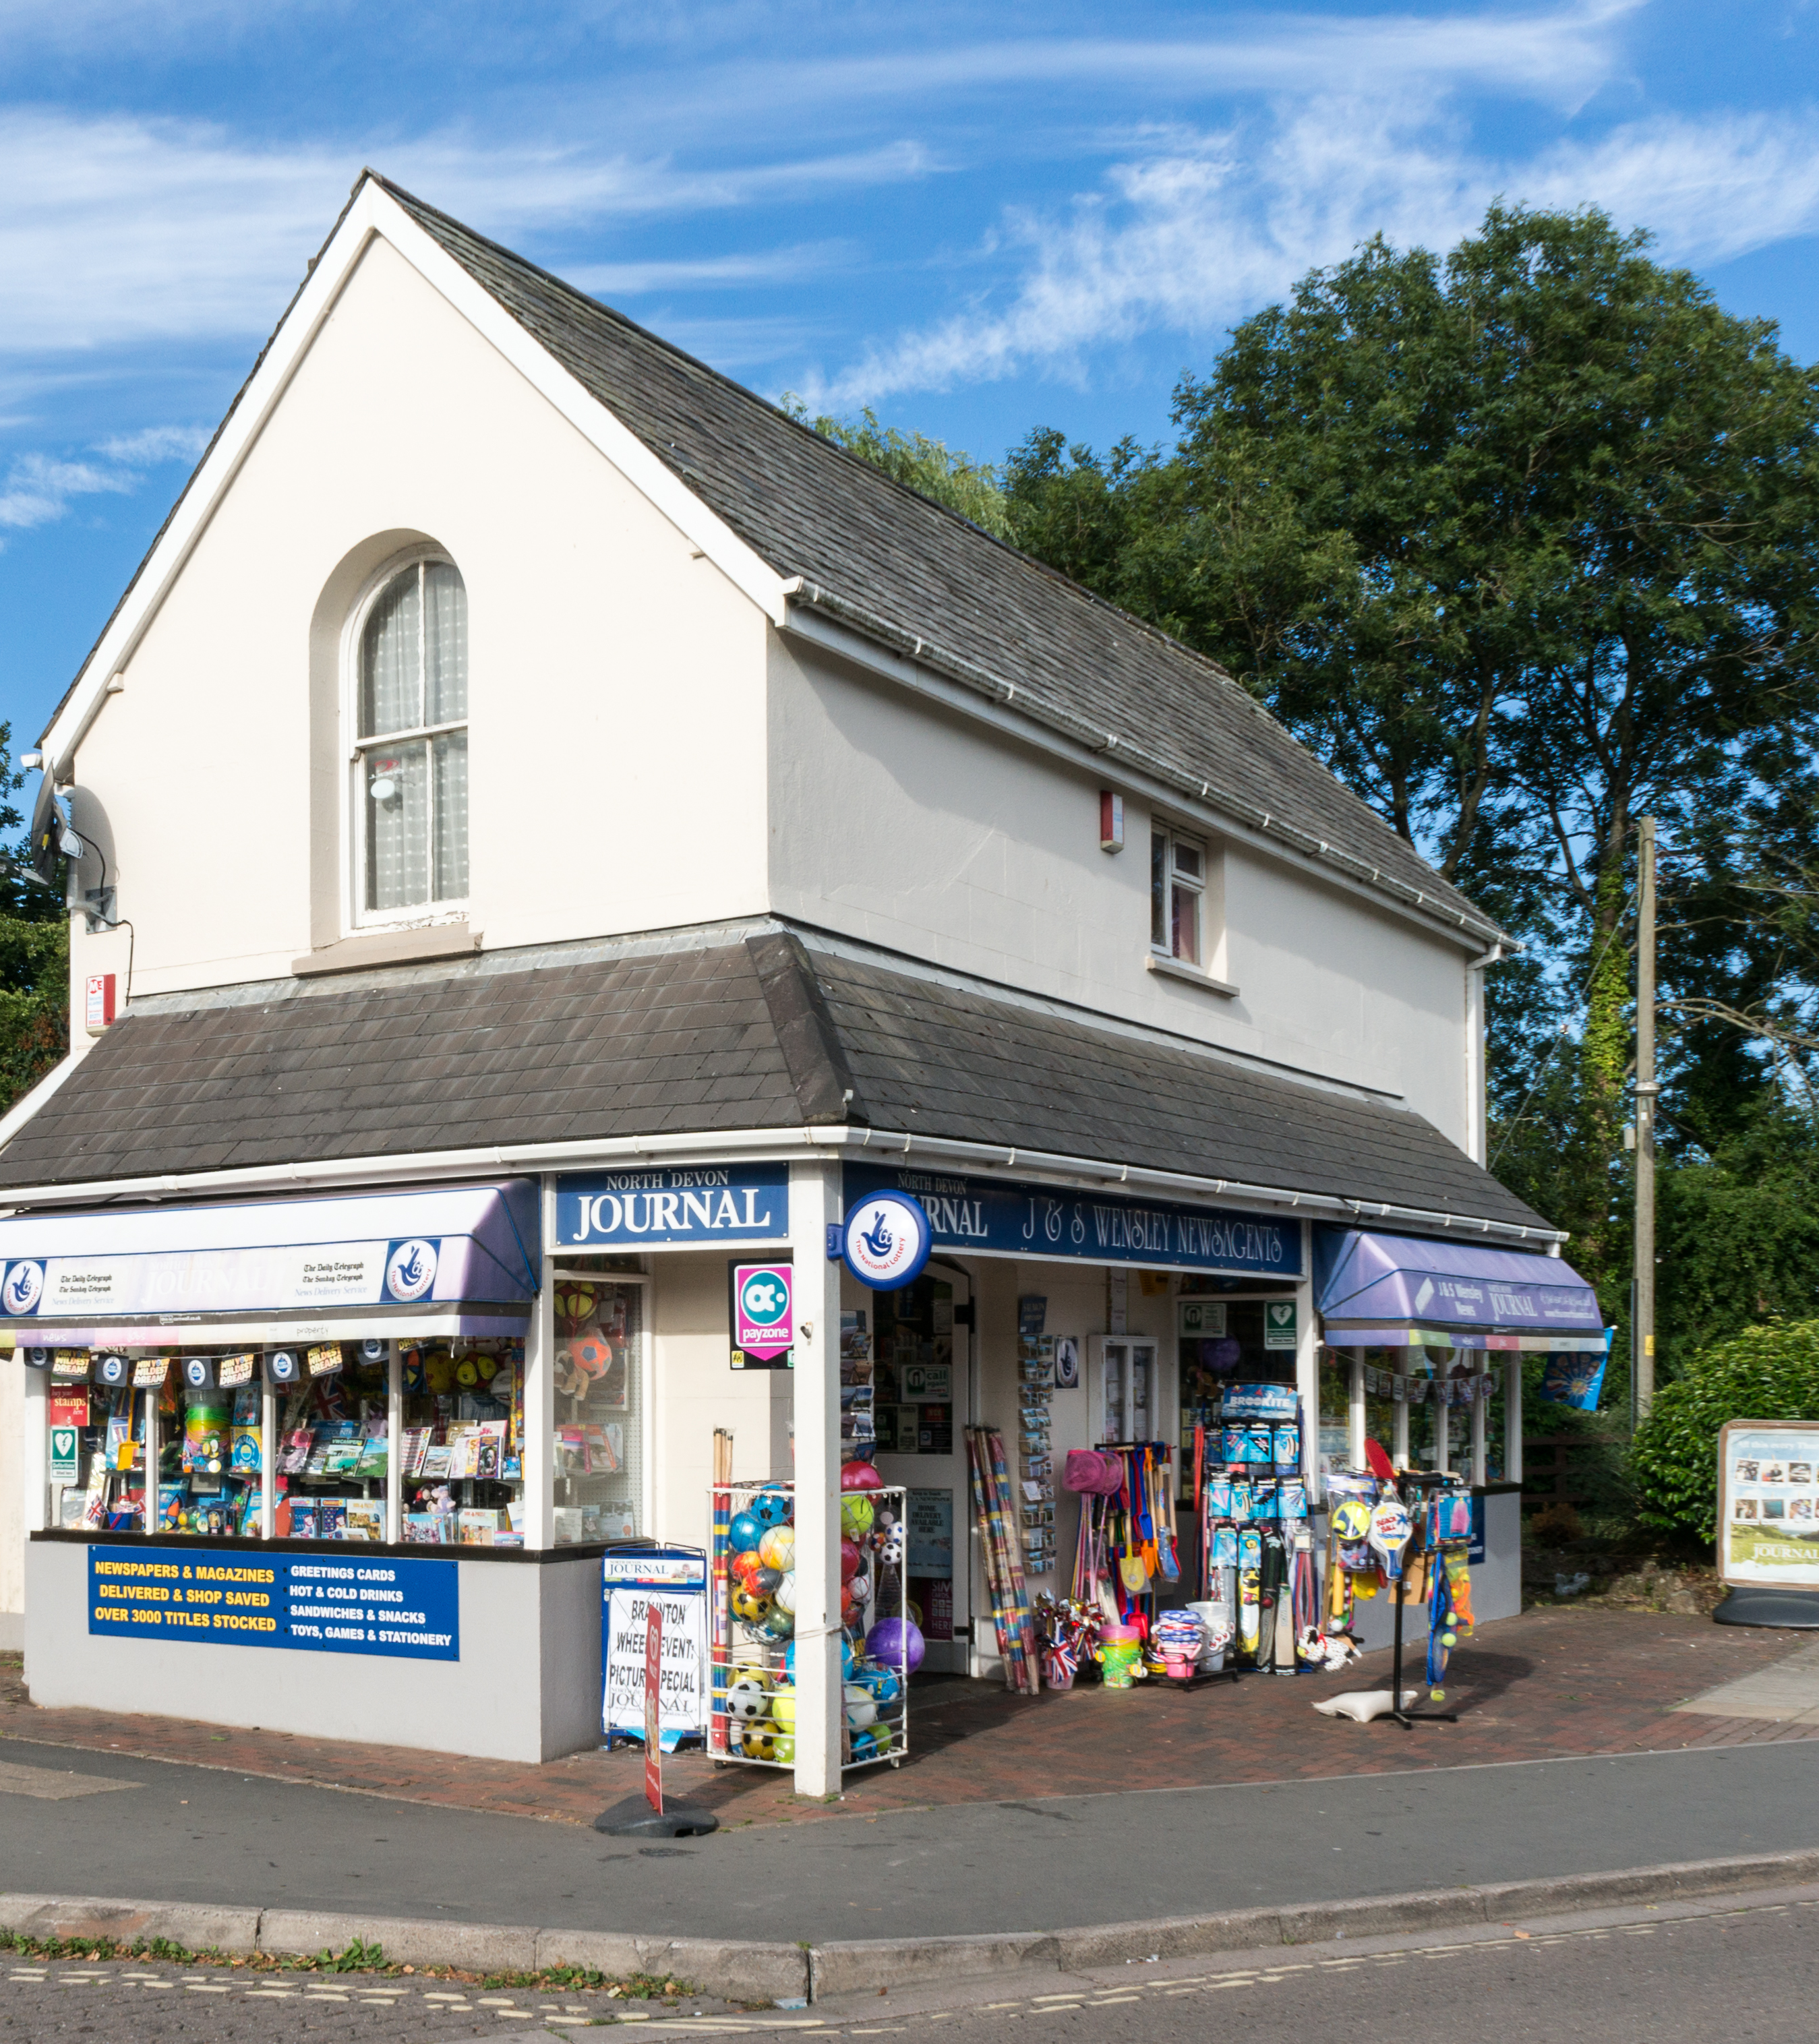
Roof Type
Gable Styled Roofs Have the overall largest negative effect on home sale price

Slide 11
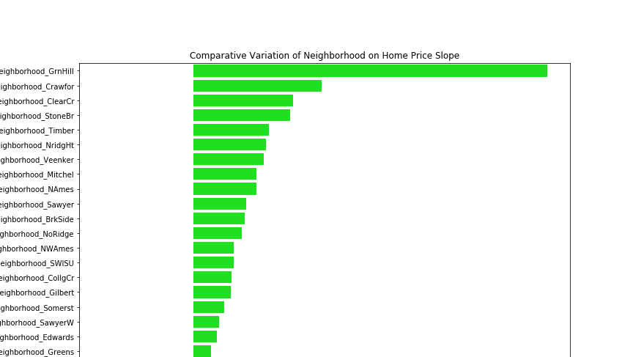
Location, Location, Location
Aside from the physical features of the home, the neighborhood will also have either a beneficial or detrimental effect on the sale price of the home.
The most desirable neighborhoods?
Green Hills
Crawford
Clear Creek

Slide 12
Conclusion:
For a homeowner looking to make changes to an existing home, the biggest impact to the home sale price would be generated by increasing the overall living area, where, all else being constant, each additional square foot added is expected to increase the home sale price by $138.
For a potential homeowner, the neighborhood, overall material quality, and overall livable square footage would be among the most important factors to consider when calculating price.
A viable strategy for a real estate developer would be to buy a lot in the desirable Green Hills Neighborhood and build a house with as large a footprint as possible

Slide 13
Further Recommendations
Due to time constraints, I was unfortunately unable to engineer as many features as I would like and I would be interested in seeing the comparative differences between Lot Size and Square footage and plotting this interaction in the model.

